Slide 1
Chapter 10: Mass-Storage Systems

Slide 2
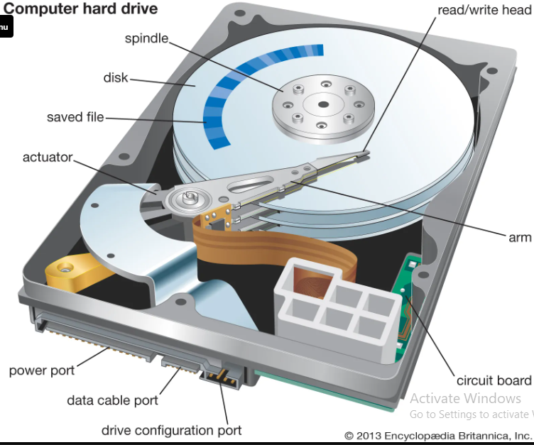

Slide 3
Overview of Mass Storage Structure
Magnetic disks provide bulk of secondary storage of modern computers
  Drives rotate at 60 to 250 times per second
  Transfer rate is rate at which data flow between drive and computer
  Positioning time (random-access time) is time to move disk arm to desired cylinder (seek time) and time for desired sector to rotate under the disk head (rotational latency)
  Head crash results from disk head making contact with the disk surface
    That’s bad
Disks can be removable
Drive attached to computer via I/O bus
  Busses vary, including EIDE, ATA, SATA, USB, Fibre Channel, SCSI, SAS, Firewire
  Host controller in computer uses bus to talk to disk controller built into drive or storage array
https://youtu.be/wtdnatmVdIg?si=avg08H5YOnS5U2Hk

Slide 4
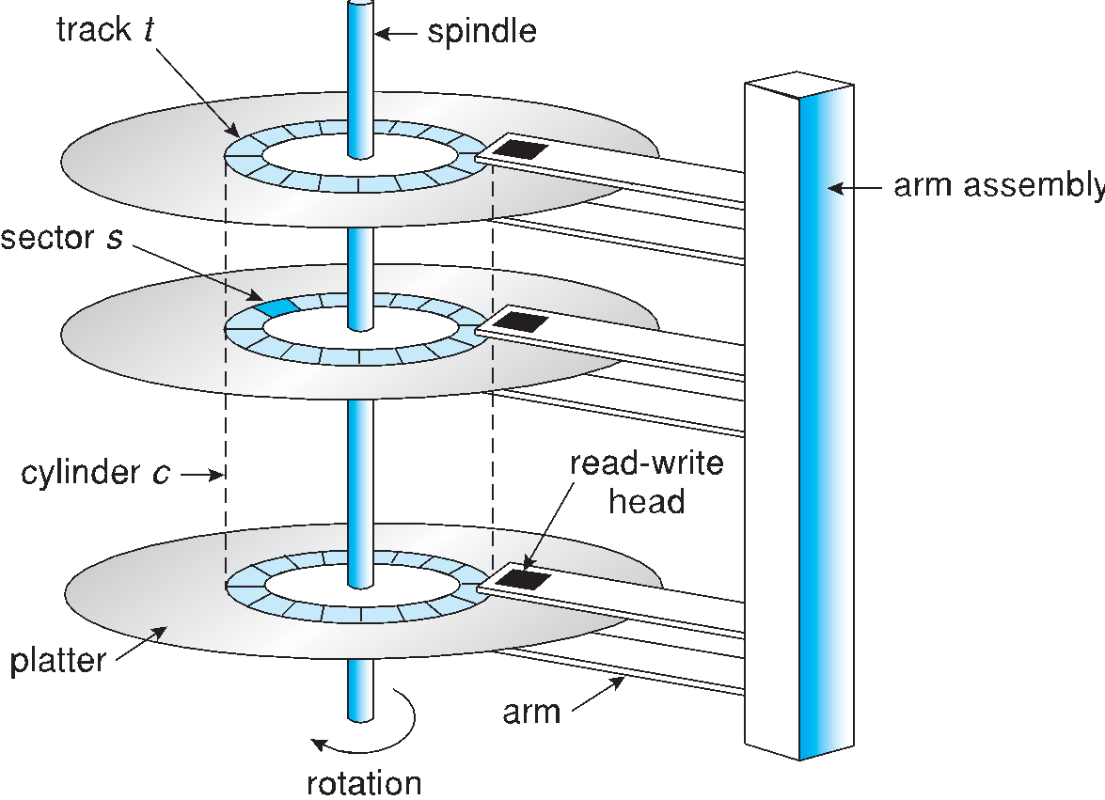
Moving-head Disk Mechanism

Slide 5
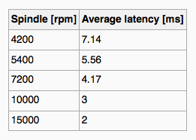
Magnetic Disks
Platters range from .85” to 14” (historically)
  Commonly 3.5”, 2.5”, and 1.8”
Range from 30GB to 3TB per drive
Performance
  Transfer Rate – theoretical – 6 Gb/sec
  Effective Transfer Rate – real – 1Gb/sec
  Seek time from 3ms to 12ms – 9ms common for desktop drives
  Average seek time measured or calculated based on 1/3 of tracks
  Latency based on spindle speed
    1 / (RPM / 60) = 60 / RPM
  Average latency = ½ latency
(From Wikipedia)

Slide 6
Magnetic Disk Performance
Access Latency = Average access time = average seek time + average latency
  For fastest disk 3ms + 2ms = 5ms
  For slow disk 9ms + 5.56ms = 14.56ms
Average I/O time = average access time + (amount to transfer / transfer rate) + controller overhead
For example to transfer a 4KB block on a 7200 RPM disk with a 5ms average seek time, 1Gb/sec transfer rate with a .1ms controller overhead =
  5ms + 4.17ms + 0.1ms + transfer time =
  Transfer time = 4KB / 1Gb/s * 8Gb / GB * 1GB / 1024²KB = 32 / (1024²) = 0.031 ms
  Average I/O time for 4KB block = 9.27ms + .031ms = 9.301ms

Slide 7
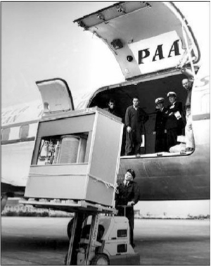
The First Commercial Disk Drive
1956
IBM RAMDAC computer included the IBM Model 350 disk storage system
5M (7 bit) characters
50 x 24” platters
Access time = < 1 second

Slide 8
Solid-State Disks
Nonvolatile memory used like a hard drive
  Many technology variations
Can be more reliable than HDDs
More expensive per MB
Maybe have shorter life span
Less capacity
But much faster
Busses can be too slow -> connect directly to PCI for example
No moving parts, so no seek time or rotational latency

Slide 9
Magnetic Tape
Was early secondary-storage medium
  Evolved from open spools to cartridges
Relatively permanent and holds large quantities of data
Access time slow
Random access ~1000 times slower than disk
Mainly used for backup, storage of infrequently-used data, transfer medium between systems
Kept in spool and wound or rewound past read-write head
Once data under head, transfer rates comparable to disk
  140MB/sec and greater
200GB to 1.5TB typical storage
Common technologies are LTO-{3,4,5} and T10000

Slide 10
Disk Structure
Disk drives are addressed as large 1-dimensional arrays of logical blocks, where the logical block is the smallest unit of transfer
  Low-level formatting creates logical blocks on physical media
The 1-dimensional array of logical blocks is mapped into the sectors of the disk sequentially
  Sector 0 is the first sector of the first track on the outermost cylinder
  Mapping proceeds in order through that track, then the rest of the tracks in that cylinder, and then through the rest of the cylinders from outermost to innermost
  Logical to physical address should be easy
    Except for bad sectors
    Non-constant # of sectors per track via constant angular velocity

Slide 11
Disk Scheduling
The operating system is responsible for using hardware efficiently — for the disk drives, this means having a fast access time and disk bandwidth
Minimize seek time
Seek time ≈ seek distance
Disk bandwidth is the total number of bytes transferred, divided by the total time between the first request for service and the completion of the last transfer

Slide 12
Disk Scheduling (Cont.)
There are many sources of disk I/O request
  OS
  System processes
  Users processes
I/O request includes input or output mode, disk address, memory address, number of sectors to transfer
OS maintains queue of requests, per disk or device
Idle disk can immediately work on I/O request, busy disk means work must queue
  Optimization algorithms only make sense when a queue exists
Note that drive controllers have small buffers and can manage a queue of I/O requests (of varying “depth”)
Several algorithms exist to schedule the servicing of disk I/O requests
The analysis is true for one or many platters
We illustrate scheduling algorithms with a request queue (0-199)
98, 183, 37, 122, 14, 124, 65, 67
Head pointer 53

Slide 13
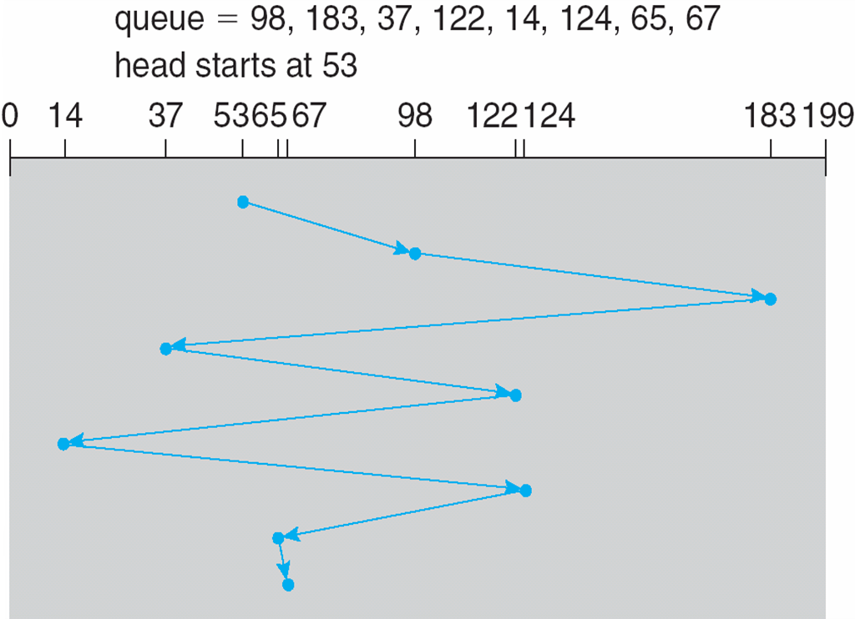
FCFS
Illustration shows total head movement of 640 cylinders

Slide 14
SSTF
Shortest Seek Time First selects the request with the minimum seek time from the current head position
SSTF scheduling is a form of SJF scheduling; may cause starvation of some requests
Illustration shows total head movement of 236 cylinders

Slide 15
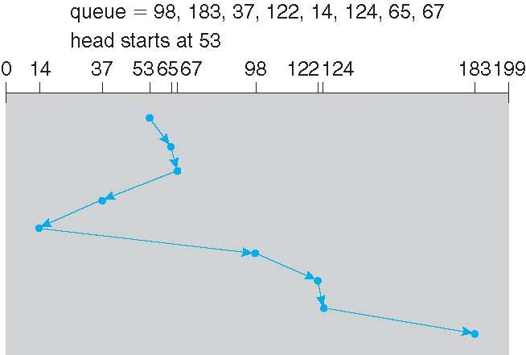
SSTF (Cont.)

Slide 16
SCAN
The disk arm starts at one end of the disk, and moves toward the other end, servicing requests until it gets to the other end of the disk, where the head movement is reversed and servicing continues.
SCAN algorithm Sometimes called the elevator algorithm
Illustration shows total head movement of 208 cylinders
But note that if requests are uniformly dense, largest density at other end of disk and those wait the longest

Slide 17
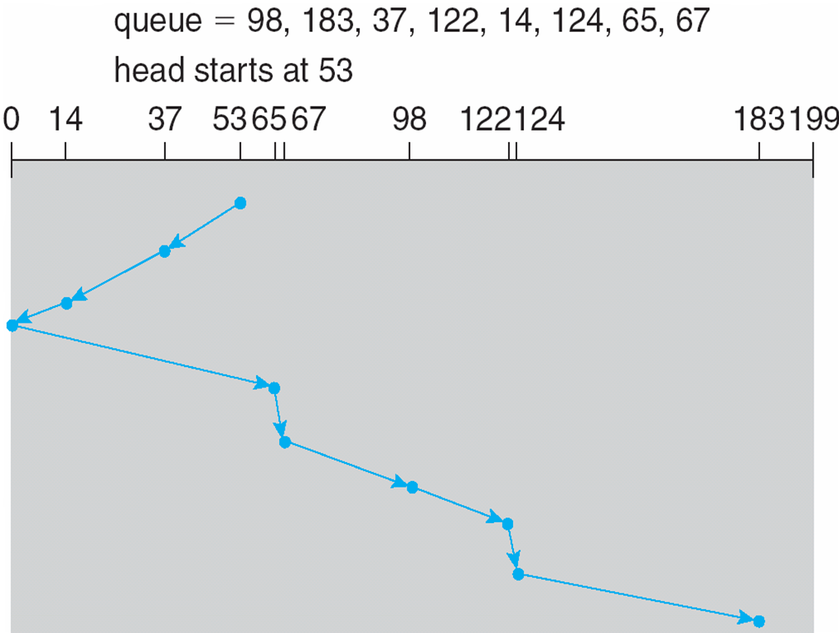
SCAN (Cont.)

Slide 18
C-SCAN
Provides a more uniform wait time than SCAN
The head moves from one end of the disk to the other, servicing requests as it goes
  When it reaches the other end, however, it immediately returns to the beginning of the disk, without servicing any requests on the return trip
Treats the cylinders as a circular list that wraps around from the last cylinder to the first one
Total number of cylinders?

Slide 19
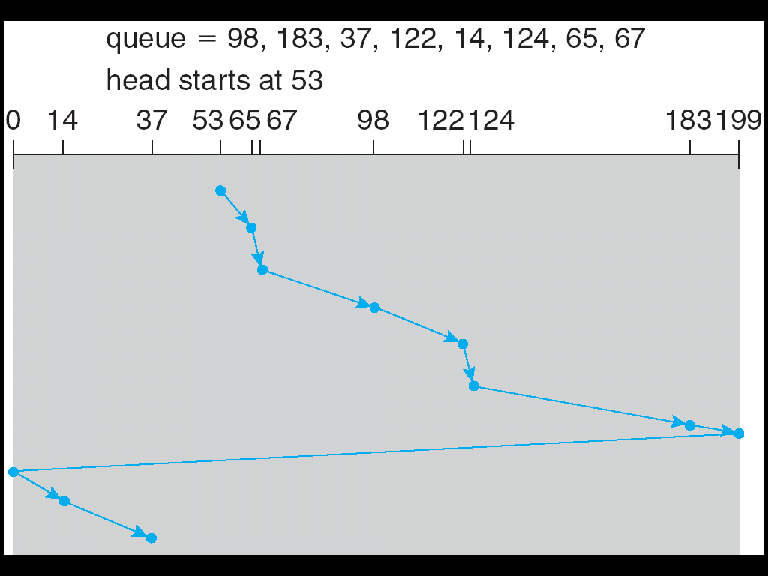
C-SCAN (Cont.)

Slide 20
C-LOOK
LOOK a version of SCAN, C-LOOK a version of C-SCAN
Arm only goes as far as the last request in each direction, then reverses direction immediately, without first going all the way to the end of the disk
Total number of cylinders?

Slide 21
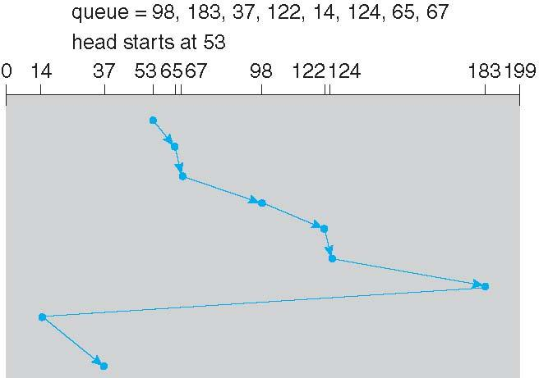
C-LOOK (Cont.)

Slide 22
Selecting a Disk-Scheduling Algorithm
SSTF is common and has a natural appeal
SCAN and C-SCAN perform better for systems that place a heavy load on the disk
  Less starvation
Performance depends on the number and types of requests
The disk-scheduling algorithm should be written as a separate module of the operating system, allowing it to be replaced with a different algorithm if necessary
Either SSTF or LOOK is a reasonable choice for the default algorithm
What about rotational latency?
  Difficult for OS to calculate

Slide 23
End of Chapter 12

